Slide 1


Pravin Kumar Rana
Sound and Image Processing Lab.(SIP)
KTH - Royal Institute of Technology
SE-10044 Stockholm, Sweden
Confidential Information
2008-12-09

Slide 2

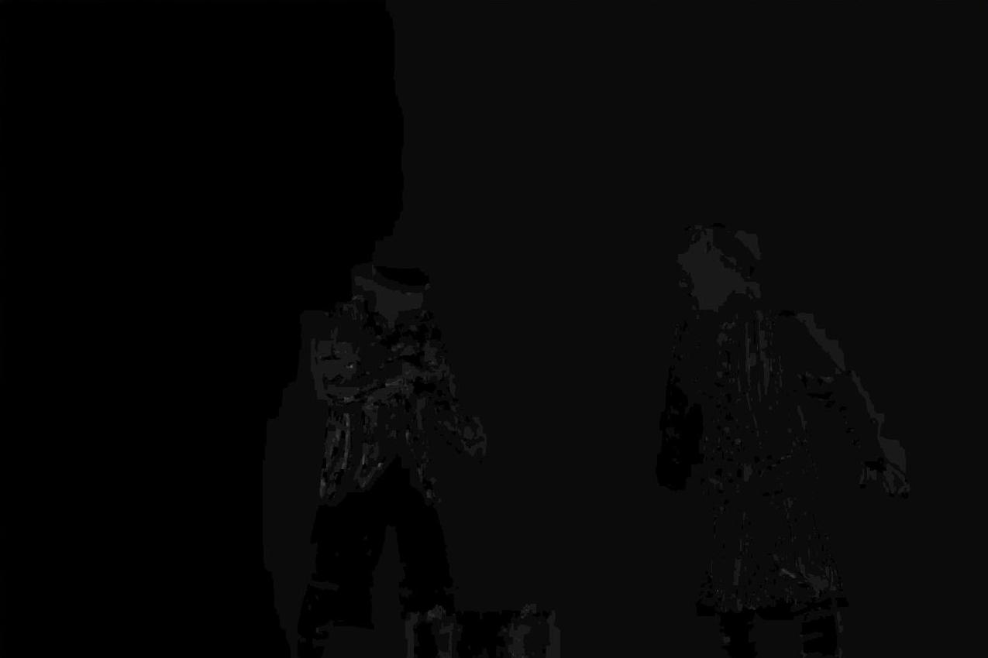
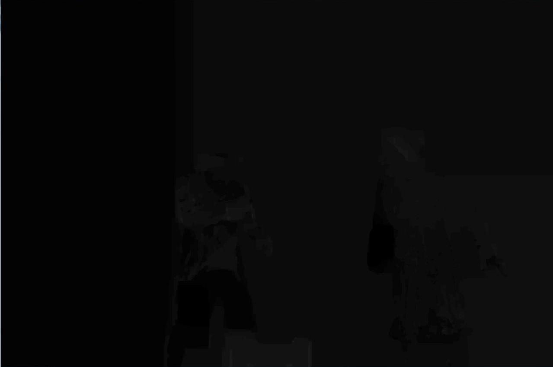
Depth Map Estimation
Experiment : 1
Experiment : 2
DepthEstimation Software
( Courtesy: Ericsson)
Confidential Information
Pravin Kumar Rana

Slide 3
Motivation
Multiview View Interpolation
via
Multi-resolution View Analysis & Synthesis
Confidential Information
Pravin Kumar Rana

Slide 4








Multi-resolution View Analysis
Common View
Error
DF₁₅
Disparity Compensated View Filter
(DCVF)
…
Error
Error
DF₁₃
DF₅₇
DCVF
DCVF
…
Error
Error
Error
Error
DF₁₂
DF₃₄
DF₅₆
DF₇₈
DCVF
DCVF
DCVF
DCVF
…
1 2 3 4 5 6 7 8 … 2^{k} views
Multi-resolution Disparity Field, MRDF={D_{ij}}
Confidential Information
Pravin Kumar Rana

Slide 5
Multi-resolution View Synthesis
2 3 4 5 6 7 8 … 2^{n} views
(1≤n≤k)
DF₁₂
DF₃₄
DF₅₆
DF₇₈
DCVF
DCVF
DCVF
DCVF
…
Error=0
Error=0
Error=0
Error=0
DF₁₃
DF₅₇
DCVF
DCVF
…
Error=0
Error=0
DF₁₅
Disparity Compensated View Filter
(DCVF)
…
Common View
Error=0
Confidential Information
Pravin Kumar Rana

Slide 6

Disparity Compensated View Filter
For example: “Haar Wavelet” type filter
Common view
x_{k}
+
DC_{k,k+1}
DC_{k+1,k}
-
x_{k+1}
+
Error
Confidential Information
Pravin Kumar Rana

Slide 7
Efficient Representation for MRDF
Goal
Represent the MRDF by “one depth image” via “suitable” geometry model
Confidential Information
Pravin Kumar Rana

Slide 8
Input Parameters Configuration
Experiment : 1
Input Parameters | Value | Details
Baseline Basis | 1 | # 0...minimum baseline, 1...maximum baseline, 2...left baseline, 3...right baseline
Smoothing Coefficient | 2.0 | # Smoothing coefficient to compute depth maps
Precision | 2 | # 1...Integer-pel, 2...Half-pel, 4...Quater-pel
Search Level | 1 | # 1...Integer-pel, 2...Half-pel, 4...Quater-pel
Filter | 1 | # 0...(Bi)-linear, 1...(Bi)-Cubic, 2...MPEG-4 AVC 6-tap
Matching Method | 1 | # 0...Conventional, 1...Disparity-based, 2...Homography-based
Confidential Information
Pravin Kumar Rana

Slide 9
Input Parameters Configuration
Experiment : 2
Input Parameters | Value | Details
Baseline Basis | 1 | # 0...minimum baseline, 1...maximum baseline, 2...left baseline, 3...right baseline
Smoothing Coefficient | 4.0 | # Smoothing coefficient to compute depth maps
Precision | 4 | # 1...Integer-pel, 2...Half-pel, 4...Quater-pel
Search Level | 4 | # 1...Integer-pel, 2...Half-pel, 4...Quater-pel
Filter | 1 | # 0...(Bi)-linear, 1...(Bi)-Cubic, 2...MPEG-4 AVC 6-tap
Matching Method | 2 | # 0...Conventional, 1...Disparity-based, 2...Homography-based
Confidential Information
Pravin Kumar Rana

Slide 10
Disparity Compensated View Filter
(Synthesis)
Common view
+
x_{k}
-
DC_{k+1,k}
DC_{k,k+1}
Error
+
x_{k+1}
Confidential Information
Pravin Kumar Rana

Slide 11
Why go for MRVS?
To improve visual quality of reconstructed views
To better utilization of available bandwidth
Confidential Information
Pravin Kumar Rana

